Slide 1
Wifi / Bluetooth Connectivity
By: Mohamed Abdi

Slide 2
Explain what the PC component does and how it fits together with other components to make up a fully functioning PC.
Wifi and Bluetooth have different roles when working with pc . Wifi connects the pc to the internet to allow it access websites and explore the internet and etc. Bluetooth is the thing that connects headphones and other wireless objects to the pc.

Slide 3
Explain how the PC component works. Provide a diagram (image) showing the main parts of the component.

Slide 4
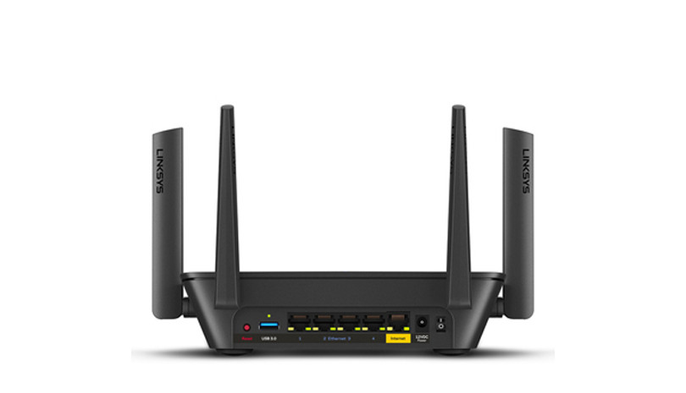

Slide 5
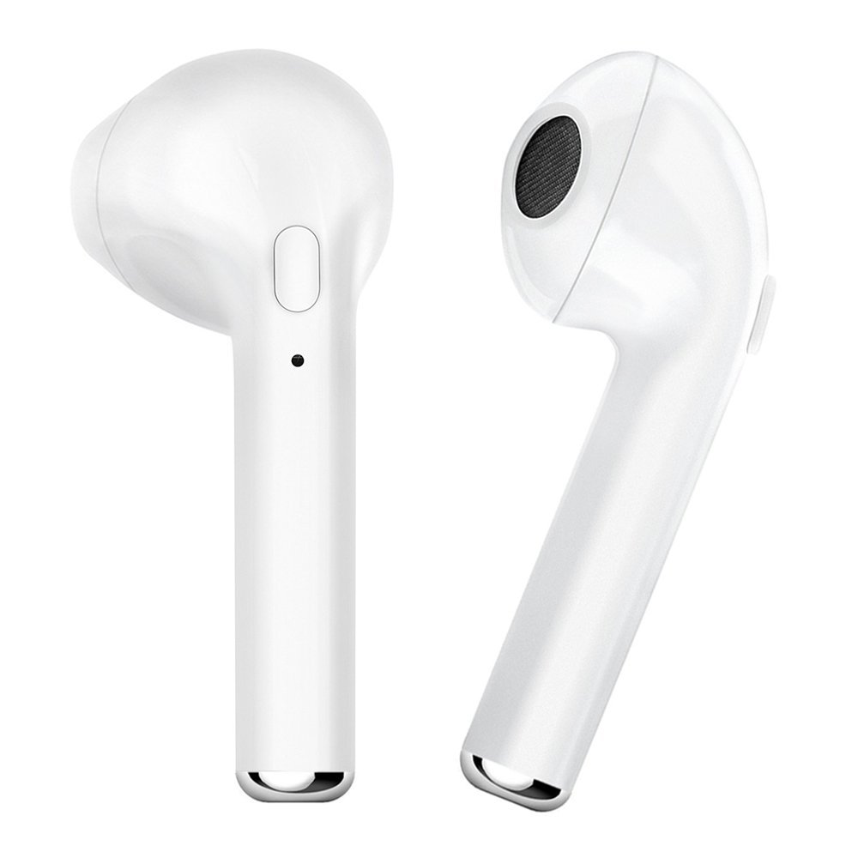

Slide 6
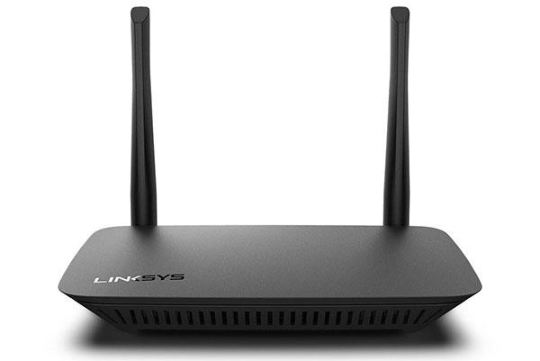
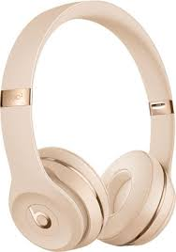
Research the current state of the art of the component in terms speed, capacity (size), and other related factors.
In terms of wifi there are different ways it comes in. It may come in a router , extender or phone hotspot. In terms of speed and capacity for a pc a router would be best for an extender it would be for phones that aren't directly connected to the router or not close to it , and for a personal hotspot that would be in a open space away from any other wifi ports. For Bluetooth it doesn’t matter they all serve the same purpose which is to connect with devices wirelessly.

Slide 7
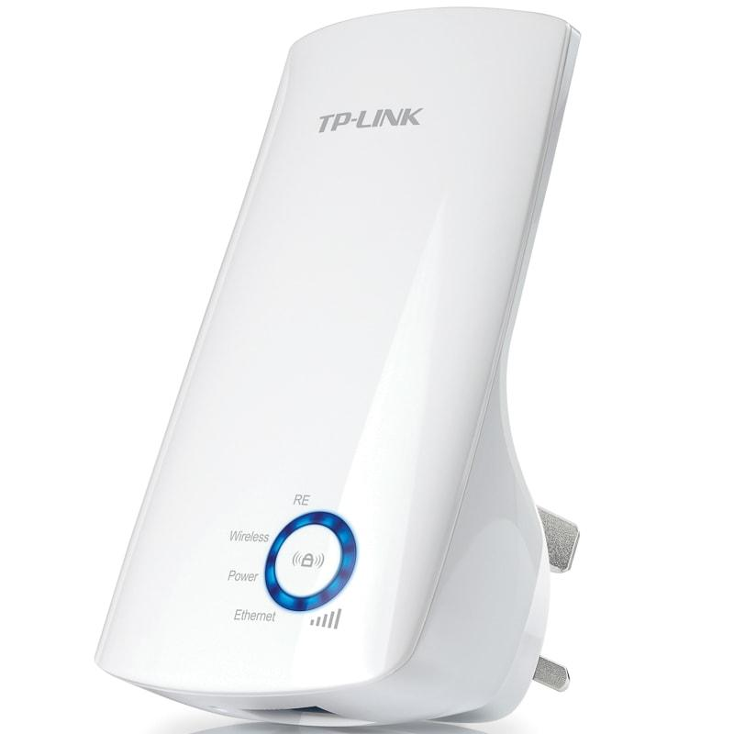
Research on-line suppliers that sell the PC Component. List the specifications for the available products and the cost (price).
Aamzon- $30-$200(wifi products ) $100-$300(Bluetooth products)
Best buy – $30-$200(Wifi products) $100-$300(Bluetooth products)
Walmart - $30-$200(Wifi products) $100-$300(Bluetooth products)
The source - $30-$200(wifi products ) $100-$300(Bluetooth products)

Slide 8
Research how the PC component has changed and evolved since the early days of PCs in the 1980’s. Cover each of the following topics separately:
Component Speed
Since 1980’s wifi and Bluetooth products have evolved heavily. Wifi was slower and much more needier in terms of things it was connected to. Internet wasn’t big so wifi wasn’t big either. Same goes for Bluetooth not many if not any Bluetooth products were around back then so it's hard to compare the times products in the two time frames.

Slide 9
Component Size / Capacity
Wifi and bluetooth products are smaller compared to the 1980’s. Nowadays wifi can come in phones , routers that are slimmer and less bulky and Bluetooth products now come in for in headphones that only have the pod part. . Although these products are smaller in size they all have a higher capacity than products in the 1980’s

